Slide 1

Pattern Representation
Dr. Umarani Jayaraman
Assistant Professor

Slide 2
Data Structures for Pattern Representation
1. Vector representation
2. String representation
3. Logical representation/description
4. Fuzzy/rough representation
5. Tree/ Graph representation

Slide 3
1. Vector representation
Patterns as vectors:
An obvious representation of pattern is a vector. Each element of the vector represent an attribute of the pattern.
e.g. : Consider a spherical object (x₁,x₂,y) where x₁ denotes weight and x₂ denotes diameter and y is the class object.
Using vector representation , a set of patterns can be represented as :

Slide 4
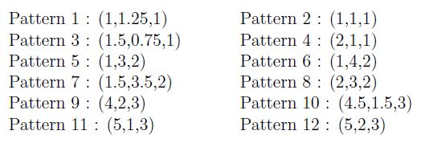
Vector representation (contd)

Slide 5
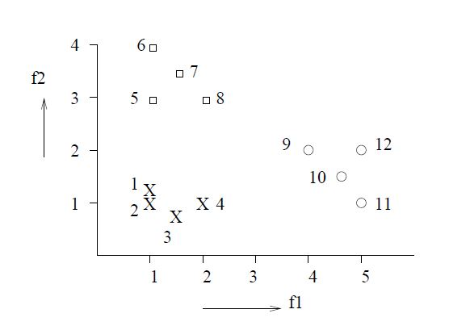
Vector representation (contd)
The above mentioned patterns is plotted as follows : (f1 and f2 are the feature axes)

Slide 6
2. Patterns as Strings
The string may be viewed as a sentence in a language.
For e.g. A gene can be defined as a region of the chromosomal DNA constructed with four nitrogenous bases.
A-Adenine, G-Guanine, C-Cytosine and T-Thymine
GAAGTCCAG----------

Slide 7
3. Patterns as Logical Descriptors
Patterns can be represented as a logical description of the form:
(x1=a1 or a2) AND (x2=b1 or b2) AND (x3=c1) ….
e.g. (color = red or white) AND (make = leather) AND (shape = sphere)
It represents a cricket ball.

Slide 8
4. Fuzzy and Rough Patterns
Fuzziness is used where it is not possible to make precise statements.
For e.g. , “If x1 is small and x2 is large, then class 3”
<small, large, 3>
It is therefore used to model subjective, incomplete and imprecise data.
In a fuzzy set, the objects belong to a set depending on a membership value which varies from 0 to 1.

Slide 9
Fuzzy and Rough Patterns (contd)
It can also be used in cases where there are uncertain or missing values : X=(?,6.2,7) or Y=([0,1],6.2,7) with no missing values.

Slide 10
Fuzzy and Rough Patterns (contd)
The values of the features may be rough values. Such feature values are called rough patterns.
A rough value consist of an upper and a lower bound.
For e.g. power ‘P’ can be represented as:
< 230, 5.2, (50,49,51)>
<Voltage, Current, Frequency>

Slide 11
5. Patterns as Trees and Graphs
Each node in the tree or graph may represent one or more patterns.
For e.g. , Minimum Spanning Tree (MST), K-D Tree, Frequent Pattern Tree (FP Tree), Delauney Tree (DT), R-Tree.
The complete set of patterns can be represented using the minimum spanning tree as follows:

Slide 12
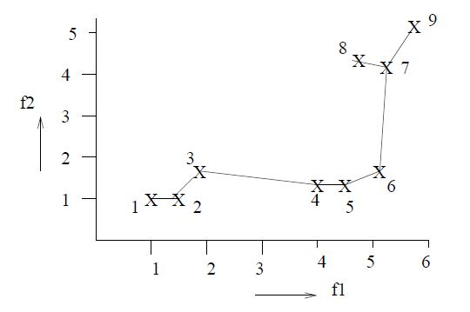
Patterns as Trees and Graphs (Contd)

Slide 13
Example: Clustering using MST
The above figure shows a pattern set of 9 points. The minimum spanning tree is shown for the 9 points.
MST can be used for clustering.
Find the edge with the maximum distance in the MST and delete that edge. Here 3-4 would be deleted.
Then find the edge with the maximum distance in the resulting tree and delete it. Now 6-7 would be deleted.
If we stop deleting edges at this point, we get three separate components. Each of these would be one cluster.
If we want four clusters, we can again find the edge with the maximum distance and delete it.
An important property is that each pattern is a numerical vector and an edge is characterized by the distance between two such vectors.

Slide 14
Summary
1. Vector representation
2. String representation
3. Logical representation/description
4. Fuzzy/rough representation
5. Tree/ Graph representation

Slide 15
Thank you

